Slide 1
Revision Record
Don’t Print This Page
Course Code
Product
Product Version
Course Version Issue
Domain
Huawei CTI
ICDV300R005C45
eSpace CC ISV V100R001C01LINH04
Developer / Modifier
Date
Approver
New / Update
Nagaraj G
2011-10-11
< Name of Approver >
New

Slide 2
CTI Basic Configuration

Slide 3

Agenda
WAS Configuration
System Configuration Management
VDN Configuration Management
DataStation Configuration
References

Slide 4
Objectives
Upon completion of this course, you will be able to:
Basic Configuration of WAS
System Configuration
VDN Configuration
VDN Configuration for making a voice Call
VDN Configuration for making an IVR Call
Data Station configuration

Slide 5

Target Audience
This course has been designed for Category of Audience:
Middle / Sr. Managers
Technical Architects
Solution Designer
Implementation engineers etc.

Slide 6
Training Pre Requisites
IPCC Overview
UAP3300 Overview
CTI Overview

Slide 7
Agenda
WAS Configuration
System Configuration Management
VDN Configuration Management
DataStation Configuration
References

Slide 8

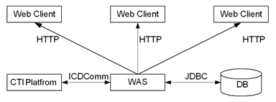
WAS Description
Web Application Server (Web Application Server, hereinafter referred to as WAS) is based on Browser / Server structure
WAS is used by the administrator for configuration management and system monitoring of a Call Center.

Slide 9
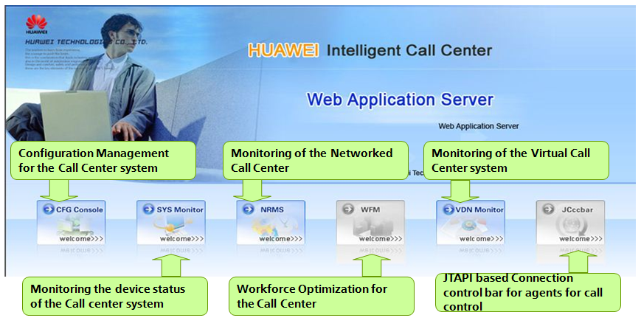
WAS Description Contd.,
http://localhost:8080/was in the IE browser.

Slide 10
WAS Description Contd.,
Huawei WAS System has the following modules:
Web configuration system: The web configuration system provides the function of configuration and management of the call center system, the networked call center, and VCC.
System monitoring console: The system monitoring console monitors the running of the devices, monitoring of all VCC’s, monitoring of all the CTI components of the call center.
NRMS (NIRC Manager System):The WAS provides the function of monitoring the networked call center
VDN monitoring console: The VDN monitoring console monitors the state of the virtual call center (VCC), including the current call traffic, agent status, agent seat site monitoring and connection rate.
Web quality manager: The Web quality manager is a system for appraising the service qualities of agents in a call center, performing QC related operations. Service qualities of agents can be improved based on the appraisal results of the Web quality manager.
Jcccbar: It is software developed using JTAPI for processing calls. The Jcccbar, provides agents with the basic call functions for processing calls and querying the call information.

Slide 11

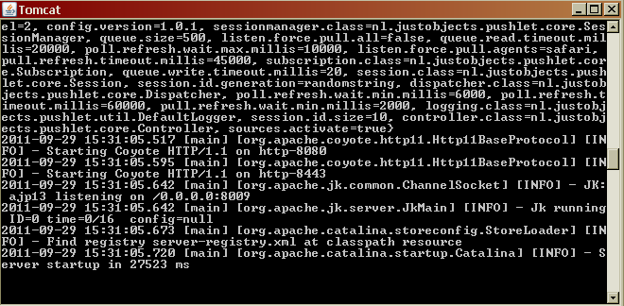
WAS Configuration Contd.,
Goto → Start → Programs → HUAWEI Web Application Server->Start WAS
TOMCAT Server for WAS is successfully started
16-Aug-12

Slide 12
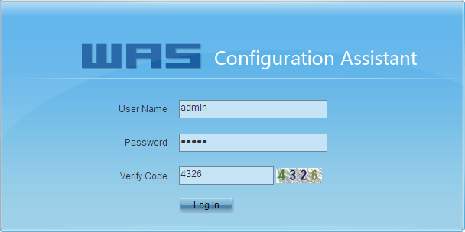
WAS Configuration Contd.,
Goto → Start → Programs → HUAWEI Web Application Server-> WAS Config Assistant
Or type http://localhost:8080/assistant in the IE browser.
1. Enter the User Name and Password (xxxxx/xxxxx).
2. Enter the WAS IP Address, Active CCS IP Address , Platform and WAS Data Source IP, if configured etc., and submit the configuration and logout.
3. Close the Tomcat Server and Re-start the Tomcat Server for the WAS to connect to the CTI Platform. MDS should be started for the WAS to connect to CCS.

Slide 13
Agenda
WAS Configuration
System Configuration Management
VDN Configuration Management
DataStation Configuration
References

Slide 14
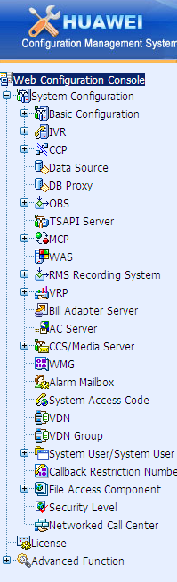
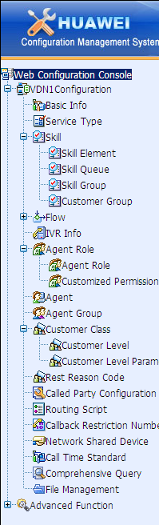
System Configuration Management
http://localhost:8080/was in the IE browser, Select CFG Console on the was page
Login to the system using the administrator account to configure the basic information of the call center system,create a new VDN’s, VDN administrators and allocate resources.
Login to VDN using the VDN administrator to configure VCC resources and business functions

Slide 15
System Configuration Management contd.,
The main objective of system configuration is to allocate resources to the VDN (Virtual Call Centers)
1
Basic Configuration
2
IVR
5
VDN
3
Datasource & Aplogic
4
System Access Code

Slide 16
System Configuration Management contd.,
System Configuration Options :-
Basic Configuration
IVR Configuration
Datasource and Aplogic
OBS Configuration
System Access Code
VDN/VCC Creation
System User Management

Slide 17
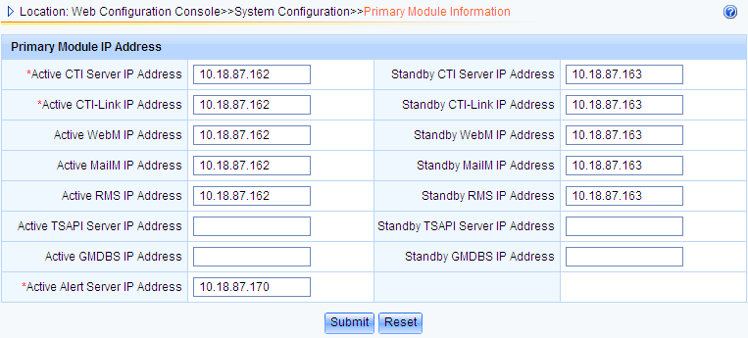
System Configuration Management contd.,
Basic Configuration
NOTE: In the WAS IE page, On the upper right corner an icon is provided to get more information on the parameters listed below.

Slide 18
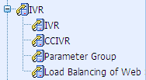
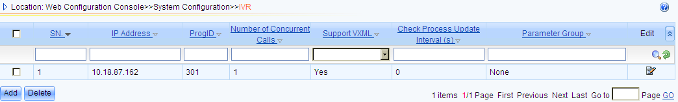
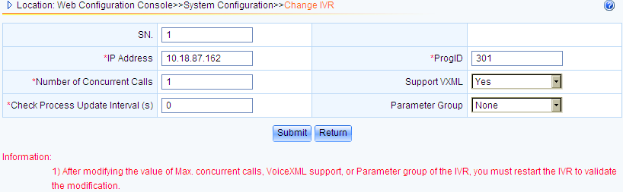
System Configuration Management contd.,
IVR Configuration
The IVR (Interactive Voice Response) and CCIVR are services provided by the call center platform for achieving automatic services and outbound call services.
Configure IVR: VXML 1.0 , VXML 2.0, GSL Standard
Configure CCIVR: CCXML 1.0 standard
Notes:
IVR:
SN:The system automatically generates a unique SN that identifies a record.
IP Address IP address of the server where the IVR is located. [Example] 10.10.10.1
ProgID Process ID of the IVR.The system automatically generates a process ID.[Value Range] 301-370
Number of Concurrent Calls Number of calls that can be concurrently processed by the IVR.
For the IVR in which only GSL flows run, the value 600 is recommended.
For the IVR in which VoiceXML flows run, the value 300 is recommended.
Support VXML Indicates whether the IVR can be loaded with VoiceXML flow files.
Check Process Update Interval (s) Interval for the IVR to automatically check whether GSL flows are updated in the directory on the CTI file server.
Parameter Group This parameter needs to be set in the following situations:
The IVR supports VoiceXML flows.
The IVR runs on UNIX or Linux, and the voice file path in the GSL flow that is loaded to the IVR changes.
CCIVR:
The CCIVR supports the VoiceXML2.1 standard-based and CCXML1.0 standard-based services. When service flows meet the VoiceXML2.1 or CCXML1.0 standards, the CCIVR must be configured to load the flows.
The CCIVR can transfers the calls which have been accessed call center platform to a third-party system for processing.

Slide 19
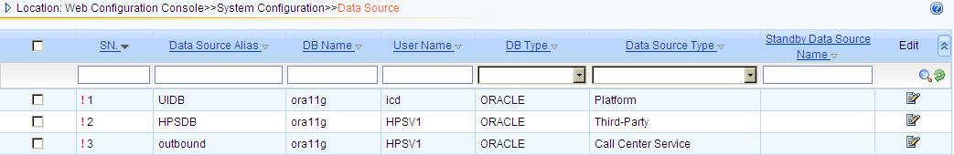
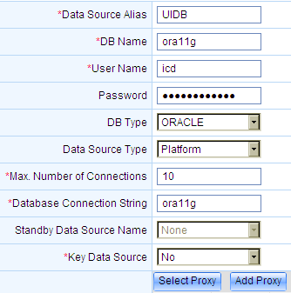

System Configuration Management contd.,
Datasource and APlogic
Datasource Types
Platform Data source
Call Center Services data source
Third party data source
DB Types supported
Notes:
SN.The system automatically generates a unique SN that identifies a record.
Data Source Alias Name of a data source.
DB Name Name of the database that is accessed through a data source.
User Name User name for accessing the data source.
Password Password of the user who accesses the data source.
DB Type The database types are as follows:
SQLSERVER
ORACLE
SYBASE
INFORMIX
DB2
GMDB
Data Source Type The options are as follows:Platform ,Calling Center Service,Third Party
Max. Number of Connections Maximum number of connections between the database proxy server and database server.
Database Connection String The setting of Database Connection String
Key Data Source After a data source is specified as a key data source, the ApLogic may restart if the data source is not properly connected.
The data sources of the Platform type must be set to key data sources. Whether the data sources of other types need to be set to key data sources depends on the actual situation.

Slide 20
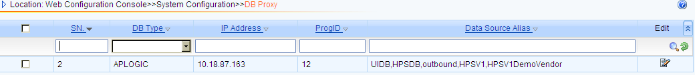
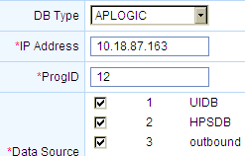
System Configuration Management contd.,
Aplogic Creation and configuration
The ApLogic is a middleware for processing database operation requests. It receives the database operation requests from the clients, executes the requests, and returns the results to the clients.
Notes:
IP Address :IP address of the database proxy server.
ProgId :ProgID of the database proxy.

Slide 21
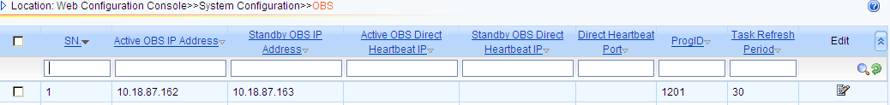
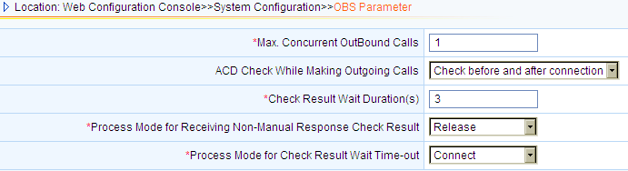
System Configuration Management contd.,
OBS Configuration
The OBS is a server provided by the call center platform for initiating outbound calls
Notes:
Max. Concurrent OutBound Calls Maximum number of outbound call channels that can be used in a call center platform.
ACD Check While Making Outgoing Calls Indicates whether the ACD check function is enabled when outbound calls are made.
The options are as follows:
Not check: indicates that the ACD check function is disabled when outbound calls are made.
Check before connection: indicates that the ACD check function is enabled before outbound calls are connected.
Check before and after connection: indicates that the ACD check function is enabled before and after outbound calls are connected.
Select it according to the actual situation.
The default value is Not check.
CAUTION: Host version negotiation must be performed if the ACD check function is enabled when outbound calls are made.
The parameters related to the ACD check function must be set when ACD Check While Making Outgoing Calls is set to Check before connection or Check before and after connection.
Check Result Wait Duration(s) If the ACD check function is enabled when an outbound call is made but the CTI Server does not obtain any check result in the duration specified by Check Result Wait Duration(s) after the outbound call is connected, the system processes the outbound call in the mode specified by Process Mode for Check Result Wait Time-out.
Process Mode for Check Result Wait Time-out The options are as follows:
Release: to release an outbound call
Connect: to connect an outbound call to an outbound call service device
Process Mode for Receiving Non-Manual Response Check Result If the ACD check function is enabled when an outbound call is made and the call check result received by the CTI Server in the duration specified by Check Result Wait Duration(s) indicates that the party who answers the call is a non-manual device such as a fax, or an answering machine, the system processes the outbound call in the mode specified by the Process Mode for Receiving Non-Manual Response Check Result parameter.
The processing modes are follows:
Release: to release an outbound call
Connect: to connect an outbound call to an outbound call service device

Slide 22
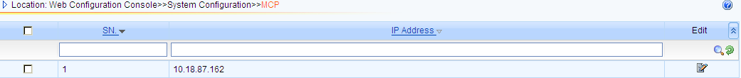
System Configuration Management contd.,
MCP (MAS CP)
The MAS connection proxy (MCP) is responsible for maintaining the connections between the CCS and agents and management system client. The call center platform supports a maximum of 99 MCP’s.
MAS : Management Application Server

Slide 23
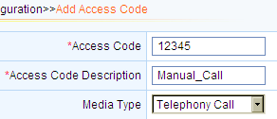
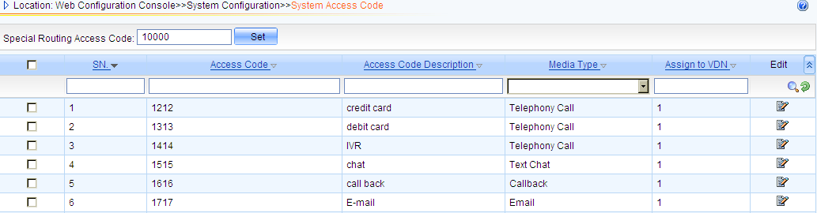
System Configuration Management contd.,
System Access Code Configuration
A system access code is the identifier of a certain service provided by the call center platform for customers. A customer can dial a system access code to obtain the detailed services provided by the corresponding service

Slide 24
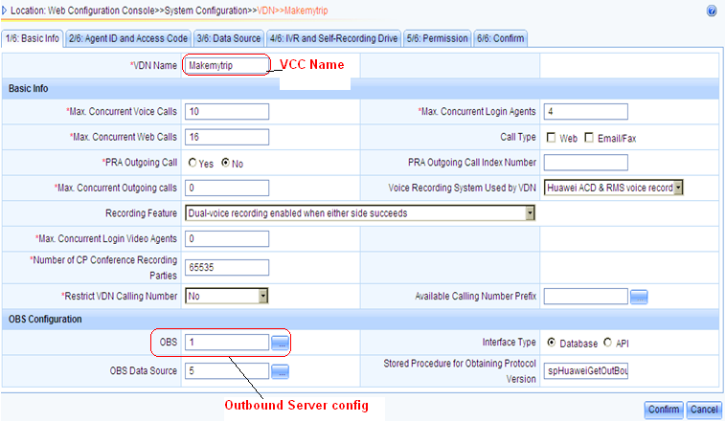
System Configuration Management contd.,
VDN/VCC Creation: Basic information on VCC creation such as no of concurrent voice calls, web calls, login agents and OBS Server configuration

Slide 25
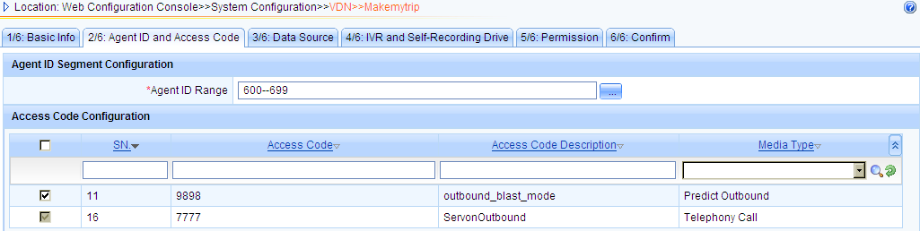
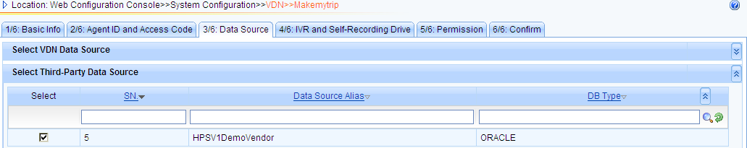
System Configuration Management contd.,
VDN/VCC Creation
Agent ID Creation and Access Code Allocation tab
DataSource Allocation to VCC
Notes:
Agent ID Creation and Access Code Allocation:
Creation of Agents range and allocation of accesscodes.
Datasource Allocation:
Allocating the database to the call center.

Slide 26
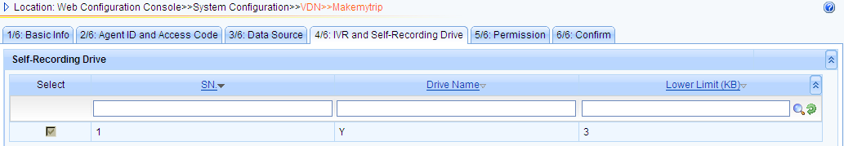
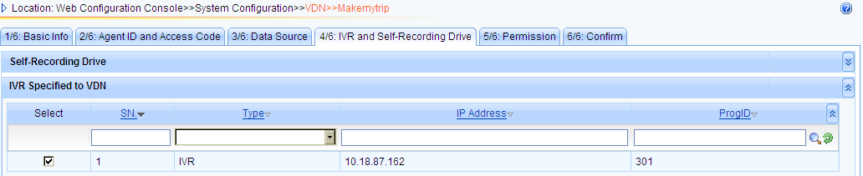
System Configuration Management contd.,
Select the Recording Drive for VDN/VCC
Select the IVR Service to VDN/VCC
Notes:
Recording Drive:
Selecting the recording drive for allocating the IVR resource.

Slide 27
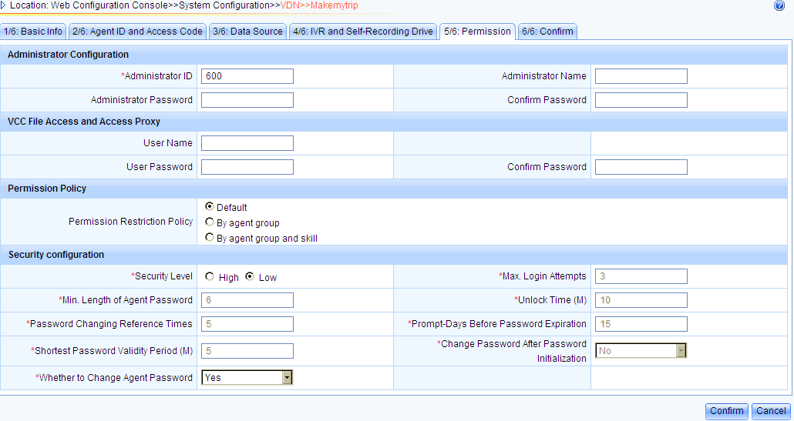
System Configuration Management contd.,
VDN/VCC Administrator ID Creation with permission and security configuration
Notes:
VCC Administrator creation with ID, username, password and security.

Slide 28
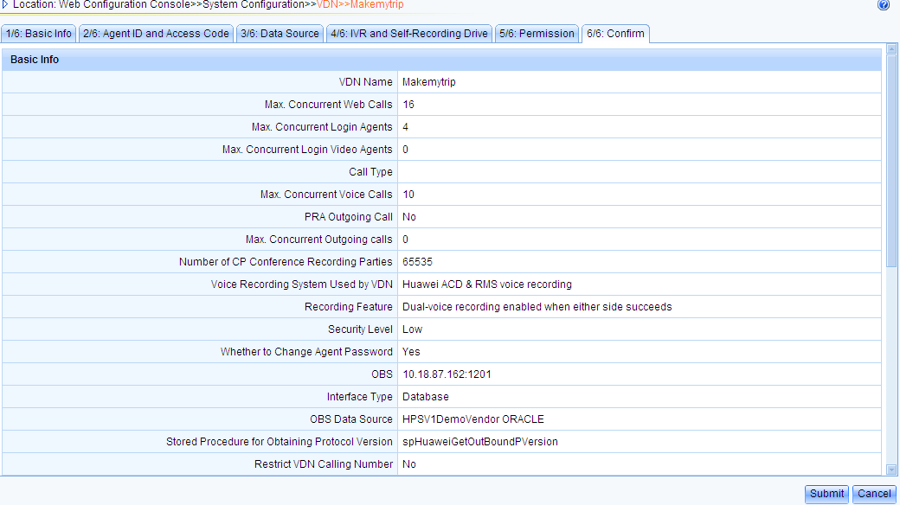
System Configuration Management contd.,
VDN/VCC configuration summary page. Select SUBMIT, to submit the configuration
Notes:
Summary of the VCC/VDN Creation which displays the configured resources. Verify details and submit the configuration

Slide 29
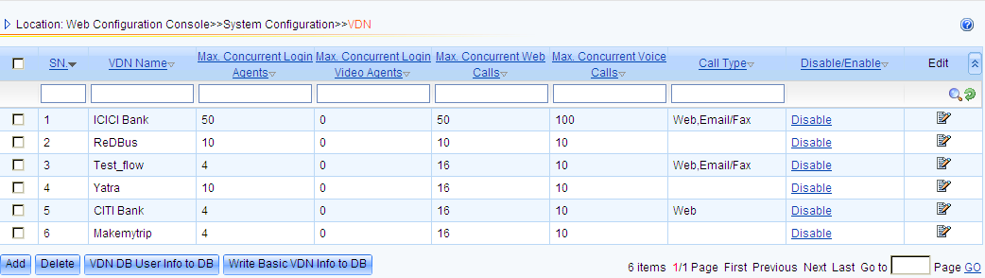
System Configuration Management contd.,
Below snapshot shows the multiple VCC’s/VDN’s created. Each VCC/VDN will act as independent call center with their own administrators, supervisors, management, reporting, agents, unique access codes etc.,
Each VDN/VCC will be independent and isolated from the other, thereby ensuring the security of data between VDN’s.

Slide 30
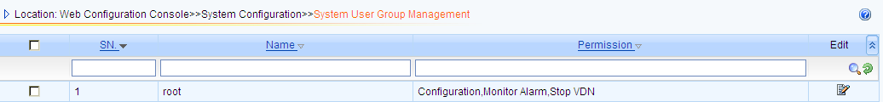
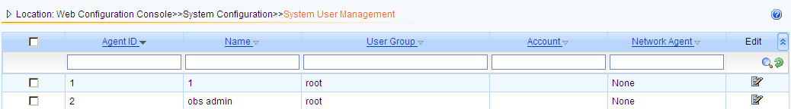
System Configuration Management
System User Management
This page is used to create system user for the call center with different rights and roles such as configuration, monitor, stop/disable VDN & Configuration Audits.
Notes:
Network Agent After a networked call center is enabled, system users need to be mapped to network shared agents if system users are required for the management of the networked call center.

Slide 31
Agenda
WAS Configuration
System Configuration Management
VDN Configuration Management
DataStation Configuration
References

Slide 32
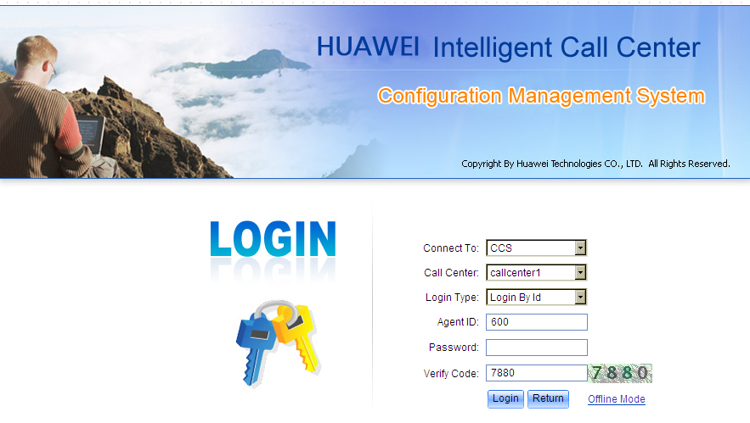
VDN Configuration Management
Enter http://localhost:8080/was in the IE browser, Select CFG Console on the was page, Login to the CFG console using the VDN Administrator Login ID , password & Verify Code

Slide 33
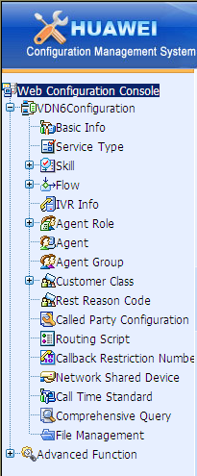
VDN Configuration Management contd.,
VDN Configuration Options :-
Basic Info Configuration
Service Type Configuration
Skill Queue Configuration
IVR or Automatic flow configuration
Agents & Role Creation
Called Party Configuration

Slide 34
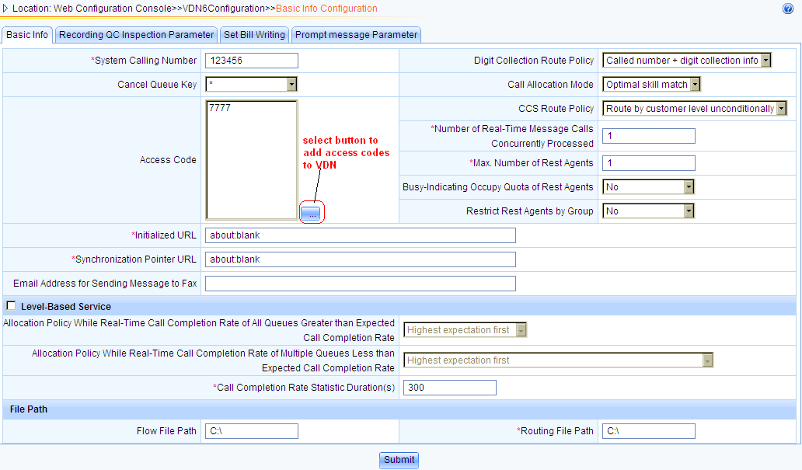
VDN Configuration Management contd.,
Basic Info Configuration Page
Notes:
This page provides the basic configuration where a access code is assigned to the VDN.
VDN Adminstrator can set the rules accordingly such as Call Allocation Mode, max no of rest agent, file path where the IVR flows will be available etc.,

Slide 35
VDN Configuration Management contd.,
Skill Queues Creation Steps
Service Type
2
Skill Element
1
4
Skill Group
3
Skill Queue
Notes:
This slides provides the info on creation fo Skill queues.
Service type need to be create eg: bill query, post paid, prepaid etc.
Skill element: Skill requirements of calls and skills that agents have are composed of skill elements
Skill queue: service type + Skill element
Skill group: A set of skills form a skill group.

Slide 36
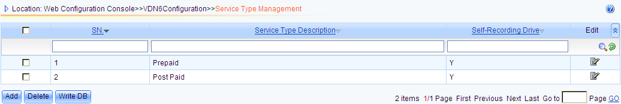
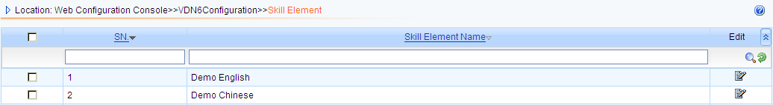
VDN Configuration Management contd.,
Service Type Configuration
Services are distinguished based on service types. Common service types include bill query, service processing, complaints and information query.
Skill Element Configuration
The basic skills that the call center agent possesses. These basic skills are called as Skill elements.
Notes:
Self Recording Drive:
Network File server mapping drive which can be accessed through nfs protocol by the system.
The files recorded by the UAP are stored to this configured drive (storage)

Slide 37
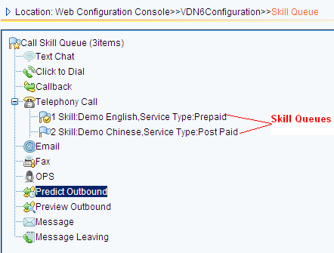
VDN Configuration Management contd.,
Skill Queue Configuration: Creation of Skill Queue using the service type and Skill element . The skill queues are created under Telephony Call which means these skill queues serve voice calls only. Can configure the same for email, Fax etc., for email and fax calls.

Slide 38
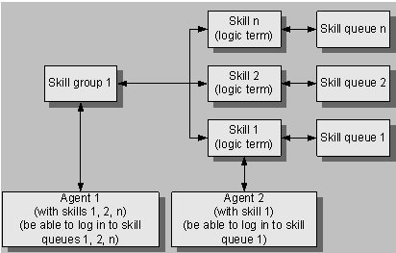
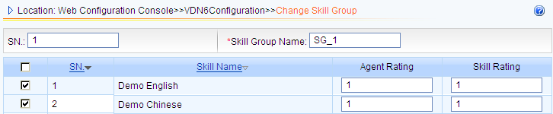
VDN Configuration Management contd.,
Skill Group Configuration
A Skill queue corresponds to a Skill. A Skill Group is a set of Skills. The figure shows the logical relationship between skill group, skill, agent and skill queue.

Slide 39
VDN Configuration Management contd.,
Agents Roles & Agent Configuration Steps
1
Role Creation
Role creation such as admin, agent, Monitor, QC inspector etc.,
Agents creation with the role created above
Agent groups creation for set of agents
2
Agents Creation
3
Agent Group
Notes:
Steps to configure the Agent and their roles:
Role creation such as admin, agent, Monitor, QC inspector etc.,
Agents creation with the role created above
Agent groups creation for set of agents

Slide 40
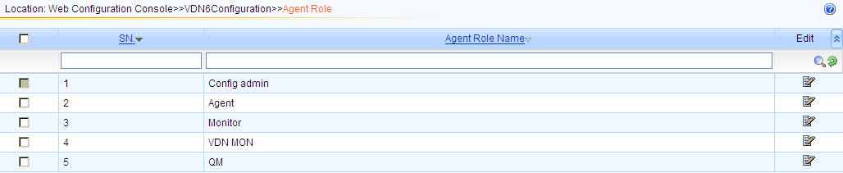
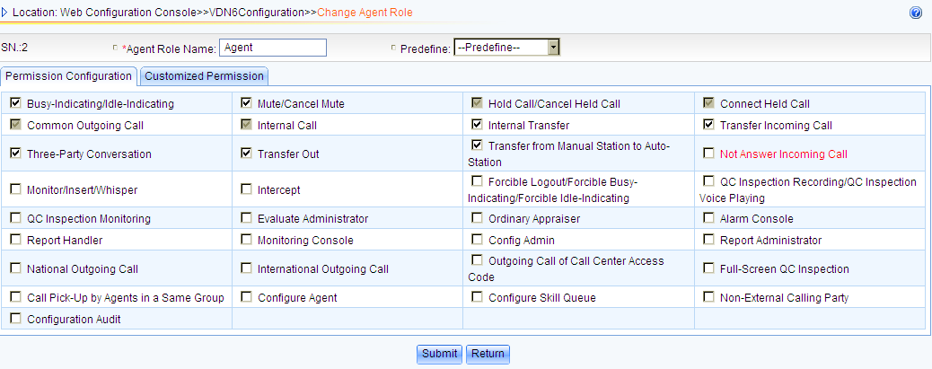
VDN Configuration Management contd.,
Agents Roles Creation
Notes:
The system defines four default roles: Ordinary agent, QC inspector, Supervisor,Technical maintenance personnel
Customized roles can also be created.
Ordinary agent Indicates the agents who provide specific services for customers.
QC inspector Indicates the agents who have the QC rights. QC inspectors check the daily work of agents by performing QC operations such as QC recording, full screen recording, and QC monitoring. This enhances the management of agents.
Supervisor Indicates the leader of an agent group that contains certain agents of the virtual call center. The agents are group to facilitate administration and report statistics.
Technical maintenance personnel Indicates the personnel who maintain the system. They do not need to provide services for customers.

Slide 41
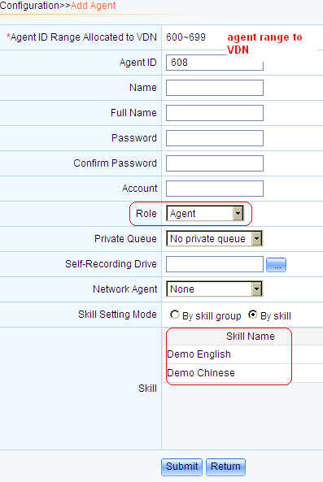
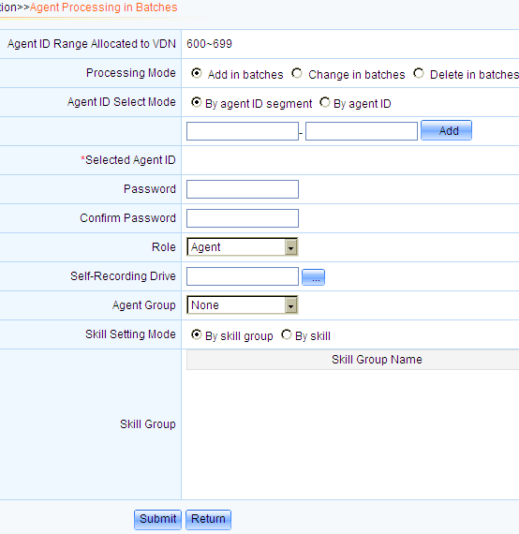
VDN Configuration Management contd.,
Single Agent Creation
Agent Creation in Batches
Notes:
This slides depicts the creation of an agent or agent in batches.
Single Agent Creation: Specify the Agent Name, password, Agent Role and skills to handle the calls.
Agent Creation in Batches: Using this page agents can be created in batches with same roles and skills

Slide 42
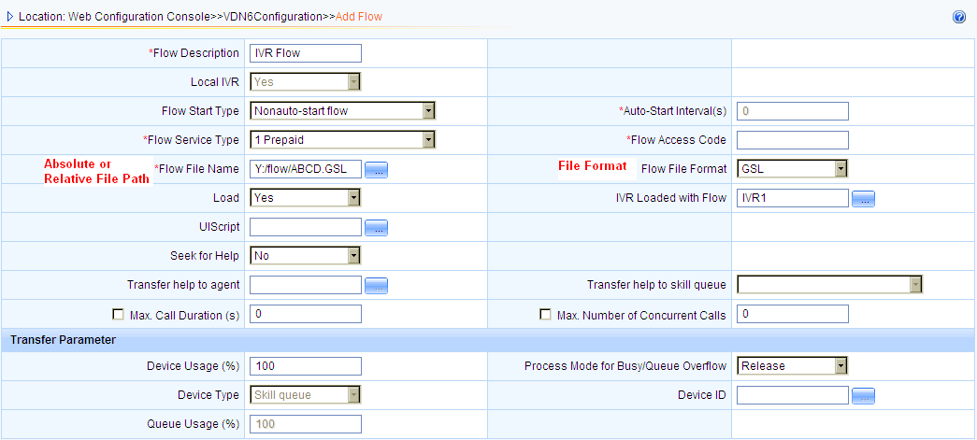
VDN Configuration Management contd.,
IVR or Automatic flow configuration
Notes:
Maximum 1500 Flows Per VDN
Flow File Format – GSL, Vxml
Flow Access Code to be manually provided for Non-auto start flow

Slide 43
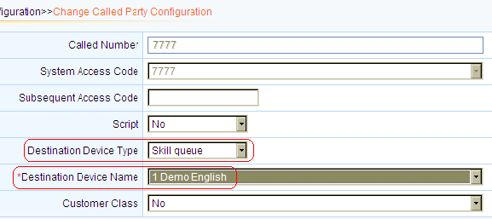
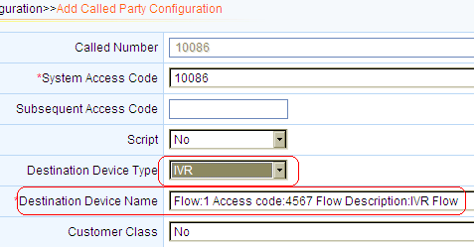
VDN Configuration Management contd.,
Called Party Configuration (Skill Queue)
Called Party Configuration (IVR)
Notes:
Called Party Configuration for Skill Queue (Inbound Voice Call):
Select the Accesscode
Select the destination device type as Skill Queue and select the skill to complete the configuration.
Once this configuration is down. When the customer calls this access code the call will be routed to the agent
Called Party Configuration for Inbound IVR Call:
Select the Accesscode
Select the destination device type as IVR and select IVR Flow to complete the configuration.
Once this configuration is down. When the customer calls this access code the call will be routed to the IVR

Slide 44
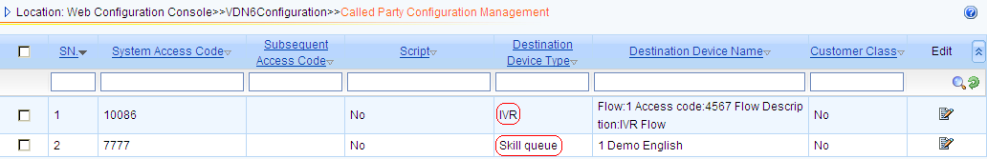
VDN Configuration Management
Called Party Configuration
For a Voice Call, the Customer can dial 7777 to reach the call center and service by agent
For a Automatic or IVR Call, the Customer can dial 10086 to reach the IVR flow.

Slide 45
Basic Inbound Voice Call
Configuration Steps to be followed to make an Inbound Voice Call to the Call Center
Start CTI MDS and see all the servers are UP and running (GREEN)
Start WAS Tomcat and check whether the WAS connects to CTI CCS.
Using the http://localhost:8080/was, open the was page and select CFG Console option.
Login in as System Administrator (1), Add the ACD Module Number (UAP’s system ID) under CCS/Media Server→ CTI Configuration and Create a System Access Code(180012345).
Create a VDN (eg: TEST) with necessary configuration such as Agent ID range, VDN Administrator and assign the system access code to that VDN.
Login as VDN administrator (101), In basic info, select the Access code(180012345) and submit the configuration, create the service type (eg: prepaid) and skill element (eg: English) and Create skill Queue under Telephony Call option.
Create Agent Role and Create Agents with Role as Agent and assign the skills to the agent.

Slide 46
Basic Inbound Voice Call
8. Add the called party Configuration with access code (180012345), select Device Type as “SKILLQUEUE” and Device Name as “SKILLNAME” (eg: English) and submit the configuration.
9. Configure the Subscribers phone in UAP (eg: 6000~6003)
Configure the prefix (180012345) with call category as Intess in UAP
Configure the prefix (6) with call category as basic in UAP.
Start Open Eye and configure the proxy Ip as UAP IP and restart.
Enter the phone number (eg: 6000) and check whether the OpenEye sip phone logs into the UAP.
Start the CTI components such as CTI-Link, Aplogic, MCP.
Start CccBar and login using the Agent ID (eg: 102) with Phone number (eg: 6000) and mode as PC+Phone. Agent Logs In.
Login another phone number (eg:6001) using the Open Eye.
Dial 180012345 from OpenEye with phone number as 6001.
The call should reach the call center and Agent phone 6000 starts ringing. Agent receives the Incoming Call from the customer.

Slide 47
Basic IVR/Automatic Inbound Call
Configuration Steps to be followed to make an Inbound IVR Call to the Call Center
Login in as System Administrator (1), Create a System Access Code(190012345) for IVR and Create the IVR Service with IP address and program ID.
Add the IVR Service to the created VDN (eg:TEST) and confirm.
Login as VDN Administrator (101) and add the system access code (190012345) in Basic Information Page.
Goto Option “FLOW” and Add/Configure the IVR flow details such as absolute or relative path of the IVR flow, flow start type, flow access code, file format (GSL/VxML) etc.,
Add the called party Configuration with access code (190012345), select Device Type as “IVR” and Device Name as “Select the IVR FLOW” and submit the configuration.
Start the IVR service with Program ID as 301, Once the IVR Service is started, it automatically loads the IVR Flow file from the path specified.

Slide 48
Basic IVR/Automatic Inbound Call
Configure the prefix (190012345) with call category as Intess in UAP
Login to the SIP Phones with phone numbers 6001 & 6000.
Dial the System Access Code 190012345 to reach the IVR of the call center using the phone number 6001.
Based on the IVR flow design, the IVR can play the prompts and may request the customer to enter the digits accordingly.
Say the IVR Flow design as an option 9, to transfer the call to the agent.
Login a agent with agent ID( eg:102), password and phone number (eg: 6000)
When the Customer selects the Option 9, the call will be released from the IVR and will be transferred to the Agent.

Slide 49
Agenda
WAS Configuration
System Configuration Management
VDN Configuration Management
DataStation Configuration
References

Slide 50
Data Station Overview
The DataStation is a tool that can process data and files, upload and download files, synchronize files, and invoke applications. DataStation can import data to and export data from the databases, such as the Oracle database, SQLSERVER database. The DataStation consists of a client and a server.
The following describes the DataStation tasks:
Transmitting Data
Downloading File
Uploading File
Exporting File
Processing File
Invoking Application
Operating File
File Agent
Group Task
Converting File
Loading File
Generating File
Notes:
DataStation Server: Windows and Linux.
DataStation Client: Only Windows.
Transmitting Data: This task is performed to transmit data periodically from a data source to a destination database, such as the Oracle database, DB2 database, Informix database, GMDB database and SQLSERVER database.
Downloading File: This task is performed to download files from the FTP or the SFTP server to the local host.
Uploading File: This task is performed to upload files from the local host to the FTP or the SFTP server.
Exporting File: This task is performed to export the database files as the text files or the DBF files periodically.
Processing File: This task is performed to filter and process the specified files periodically. Processing a file indicates deleting or modifying the extension name of the file and moving the file to a specified path.
Invoking Application: This task is performed to invoke applications periodically.
Synchronizing File: This task is performed to monitor file changes and synchronize the modified files from the source host to the destination host.
Operating File: This task is performed to operate files on the local host or FTP nodes. Operating a file indicates uploading the file to, and downloading or deleting the file from the local host or the FTP nodes.
Synchronizing Command: This task is performed to set the synchronization task on the client. In this case, the system generates the corresponding rsync command on the DataStation server. The synchronization command can be run periodically to synchronize the directories on the source host and on the destination host.
File Agent: This task is performed to upload or download files according to the received UDP messages.
Group Task: This task is performed to execute a group of tasks periodically. The tasks in the group, including Transmitting Data, Downloading File, Uploading File, Exporting File, Processing File, Invoking Application, and Operating File, Converting File, Loading File, Generating File are executed in a sequence.
Converting File: This task is performed to convert certain or all fields specified in a binary file into a binary or text file.
Loading File: This task is performed to parse and load files in specified formats.
Generating File: The task is performed to generate files in specified formats.

Slide 51


Obtaining Data Station Software
Extract the ICD V300R005C35-public ICD.rar, to get the data station version DataStation V100R001C04B030 directory for windows.
Refer to DataStation Installation Guide (v100r001c04b030) for installation of DataStation Server and DataStation Client.

Slide 52
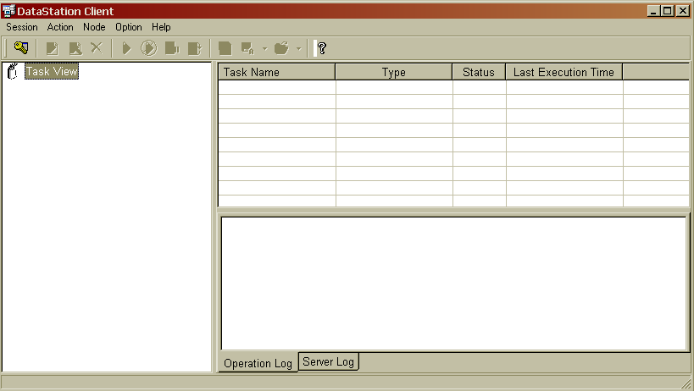
Data Station Configuration
Double click on the datastationshield.exe
A Window Opens, Click on the Start Data Station.
DataStation Server is started.
Double click on the DataStationCli.exe, The below window is displayed

Slide 53
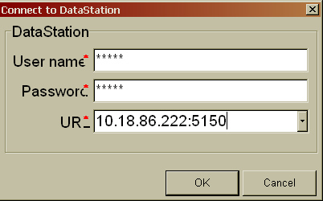
Data Station Configuration
On the Client Window, Select Session → Connect
To login to the datastation client, enter the username, Password and the URL
Username/Password: xxxxx/xxxxx
URL : IPAddress:port ( Datastation Server IP Address)

Slide 54
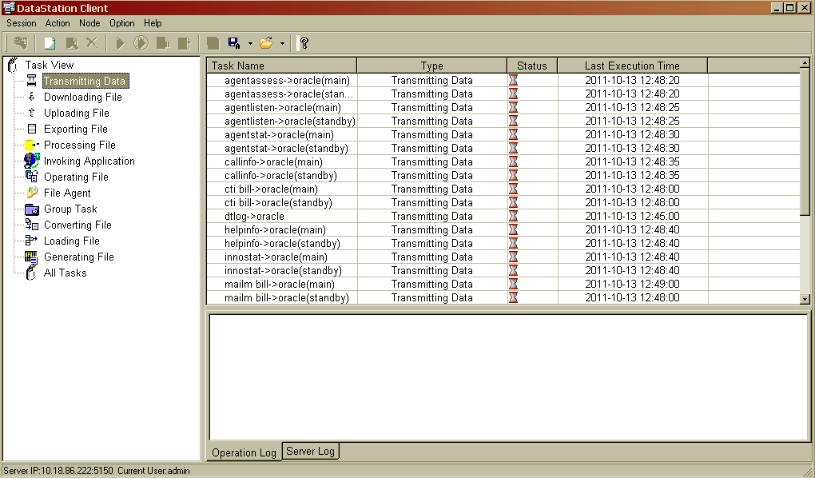
Data Station Configuration
7. Below are the default tasks, New tasks can also be created. By default tasks are available for Main and backup CTI’s which can be scheduled.

Slide 55
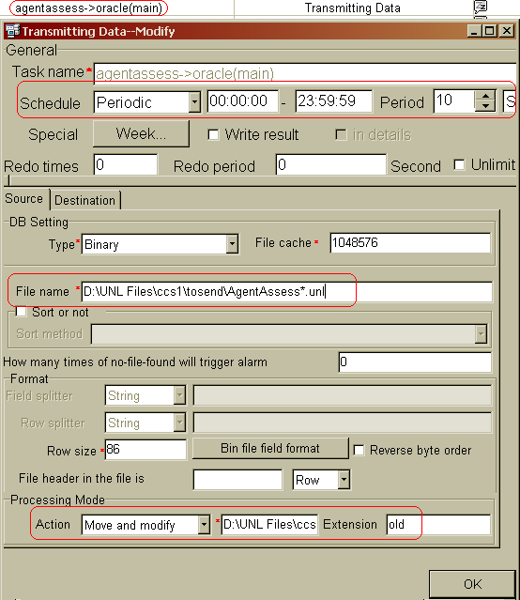
Data Station Configuration
The binary (.unl) bill files of CTI are generated in the Machine where the CTI is installed. In Windows the default bill path = d:\bill\ccsbill
In Linux the default bill path = $ICDDIR/bill/ccsbill
9. Double click on the task agent assess(Main). A window appears as shown.
Notes:
Schedule : The Schedule can be configured to transfer the binary bill logs (.unl) files from the CTI machine to the database.
Here its 10 secs, every 10s, the task is scheduled and binary bill log files are transferred to the database in human readable format.
FileName: This is the path created by the CTI during the installation and running where the binary log files are generated.
Provide the absolute path.
Action: Once the file is read and content is put to DB, move the file to another location for backup.
Action Include: Delete, Move and modify, modify extension, Move to & advanced setting.

Slide 56
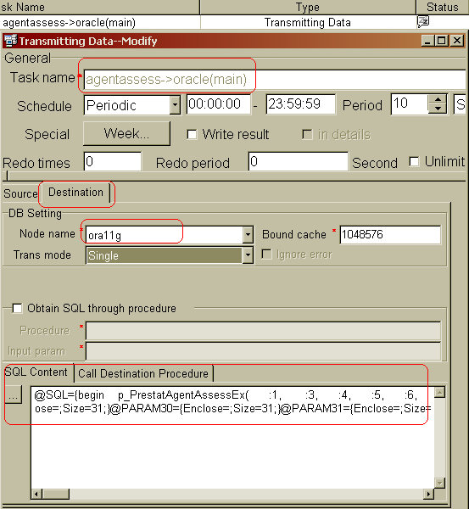
Data Station Configuration
Select the destination tab, specify the SID of the database used.
11. SQL Content:
SQL Query written to read the binary file and export the data to a table in the database which is in human readable format
Same Procedure has to be followed for configuring all the main and stand by task for scheduling.
13. Go to database and query the database table t_AgentAssess to see the data
Notes:
SID: Service Identifier of Database.

Slide 57

Data Station Configuration
14. Once the tasks configuration is completed and scheduled, each tasks will run at their scheduled time and export the binary file to database. Below are the logs of data station exporting the agentstat and Call info binary files to database.

Slide 58
Agenda
WAS Configuration
System Configuration Management
VDN Configuration Management
DataStation Configuration
References

Slide 59
References
WAS Configuration Reference:
HUAWEI Call Center WAS Installation Guide
[check for the configuration section]
http://support.huawei.com/support/DocView.do?doc_id=SE0000535392&doc_type=ProductManual-soft
CTI Configuration Reference:
System and VDN Help Files
DataStation Reference:
DataStation Installation Guide (v100r001c04b030)

